Slide 1
ANANDA
FOUNDATION

Slide 2
ONE HEALTH

Slide 5
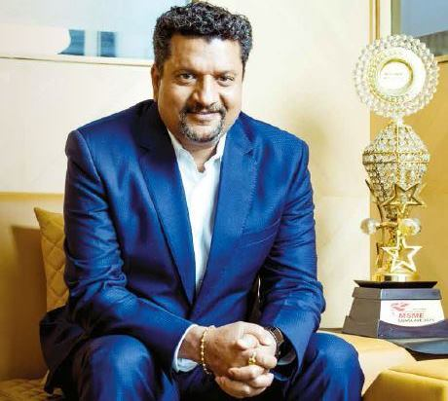
“In our industry 75 percent of our Raw Material is Milk, so we work very closely with farmers”
Leading Milk and Milk Products Manufacturer
Dairy products, the main type of products handled by Ananda, are sometimes referred to as gifts from heaven, as they contain almost all the daily nutrients we need.
In recent times, major advances in food processing technology have allowed us to create a wide variety of different dairy products, such as condensed milk and products made from milk extracts. As a result, dairy products are now used in a wide range of areas such as the health food and medical fields, in addition to the traditional area of food ingredients. That means Ananda is directly involved in supplying ingredients to people of all ages – from infant to elderly person.
Farmers are integral to Ananda Dairy’s operations. In our industry, 75 per cent of our raw material is milk so we work very
closely with farmers, We take their pain as our pain. We oversee their feed management, cattle management, and research and design. We do a lot of things to make sure they grow and that their yield is efficient.
We started our own factory of cattle feed which produces 200 tonnes per day, We have a very good team. We have a principal genetics scientist who focuses on the agriculture and a lot of the feed we are doing. We have 20 veterinary doctors and a solid research and design team. We have 200 workers who do artificial insemination of the cattle and we have company-owned call centre.
India has a high protein deficiency rate, which is something we wants to change. According to a survey conducted by market research firm IPSOS, in conjunction with InBody India, approximately 68 per cent of people in India are protein deficient. There are several reasons why. First, India has a large number of vegetarian people who are found to have a higher protein deficiency than non-vegetarians.
Another reason is the rice- and wheat based diet. Protein deficiency can cause low immunity, low energy levels, loss of muscle strength and poor sleep. Dairy – along with poultry, fish and lean meat – is a good source of protein and we wants to promote its benefits in India.
“We have made a mission that we will work on dairy-based protein, There’s a huge opportunity for it here.”
Corporate Philosophy
We are transforming Ananda into a company that contributes to the development of food culture worldwide.
Our goal is to continue growing and developing as a company that makes a difference to society. Based on strong relationships of trust with the farmers and consumers, we will ensure stable supplies of reliable and safe food and ingredients to our customers, ultimately contributing to consumers’ nutrition, health and enjoyment of food.
Radhey Shyam Dixit Managing Director

Slide 6
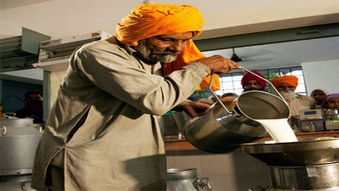
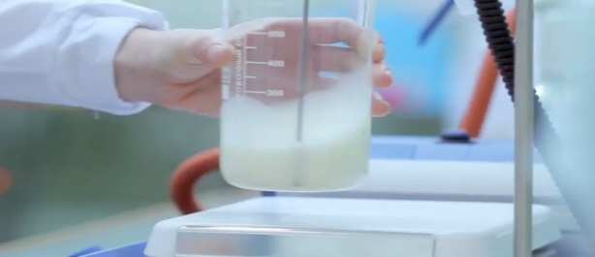
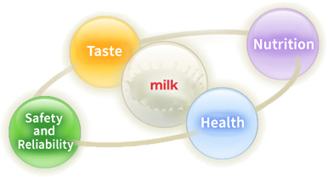
Our Strengths
We, Gopaljee Dairy Foods Private Limited, strive to provide only international quality dairy products to all our customers. One of the biggest factors for the success of our group has been the vast network of milk collection that we have in place. We procure our high quality milk directly from farmers in many villages all over India. Our vast network encompasses more than 2 Lakh farmers from over 6000 villages, with the help of 36 milk chilling centers (MCC). The milk collection is done twice daily, in order to maintain the freshness of the milk, it is then transported to the nearest MCC and is stored in refrigerated conditions before it is further sent for processing and packaging.
Our methods and processes to ensure high quality and safety of our products is governed by our Quality Policy document, which emphasizes our commitment to winning the trust and faith of our customers by consistently matching their expectations and preferences. All our products are manufactured adhering to the standard industry policy and guarantee 100% external and internal food safety. We have successfully adopted a policy, which means that everyone in our company is working with no-wastage policy.
Our research and development wing is one of the major contributors in the massive success of our organization, milk offers endless possibilities for innovation to meet changing consumer preferences and nutritional needs. We understand that milk is not only a source of nutrition but also of pleasure, happiness and taste, and that is why we are constantly involved in the innovation of new products to delight our customers. Innovation has been one of the governing philosophies ever since our inception, and we have been dedicated to enhancing people's lives through our products.
The superior packaging and labelling processes of our organization ensures that the customers are presented with all the necessary information on how to consume or store the product. This is done in order to ensure that all our products are used safely and maintain the highest level of quality throughout.
Our well established customer service process ensures that we promptly reply to any question, query or concern. Further, all the labels of our products have our address and telephone number if any of our customers want to contact us.
▼
▼
▼
▼

Slide 7
Our Strengths
Ananda’s strengths come from its focus on food products and its market information gathering capabilities.
These strengths are applied at every level of the value chain, allowing us to source and deliver the products customers really need.
We, Gopaljee Dairy Foods Private Limited, can confidently say that our company's superior milk procurement, production and quality is our biggest strength. We have a vast milk procurement network to provide customers with fresh, pure and nutritious products directly from the farm. We have network that reaches over 200,000 farmers in over 6,000 different Indian villages. We have over 36 chilling and storage facilities all over the country with the capacity to collect over 7 Lakh Litres of milk daily and the capacity to handle over 10 Lakh Litres of milk per day. We firmly believe that the biggest asset of organization is its employees, that is why, we are proud to say that our highly dedicated workforce of over 2500 people is the backbone of this company.
Human Resources
Advanced Expertise and Information Gathering Capabilities
Highly specialized food product experts providing unrivaled services
Our staff provide customers with high added value by drawing on expertise built up over many years in the frontline of dairy product distribution. Their expertise and know-how is also passed on to other employees through extensive human resources training and development.
Milk Procurement
Qualities and Safety Policies
Research, Innovation and Development
Consumer Needs/ Services
Customers
[Food Product Manufacturers]
Suppliers
Milk Procurement System: the backbone of Fresh Dairy Products
International standard quality is our organization's topmost priority
Our R&D guiding philosophy is to fulfil the nutritional needs of people all over India.
Offering products and solutions that preempt customers need
▼
▼
▼
▼
We, Gopaljee Dairy Foods Private Limited, strive to provide only international quality dairy products to all our customers. One of the biggest factors for the success of our group has been the vast network of milk collection that we have in place. We procure our high quality milk directly from farmers in many villages all over India. Our vast network encompasses more than 2 Lakh farmers from over 6000 villages, with the help of 36 milk chilling centers (MCC). The milk collection is done twice daily, in order to maintain the freshness of the milk, it is then transported to the nearest MCC and is stored in refrigerated conditions before it is further sent for processing and packaging.
Our methods and processes to ensure high quality and safety of our products is governed by our Quality Policy document, which emphasizes our commitment to winning the trust and faith of our customers by consistently matching their expectations and preferences. All our products are manufactured adhering to the standard industry policy and guarantee 100% external and internal food safety. We have successfully adopted a policy, which means that everyone in our company is working with no-wastage policy.
Our research and development wing is one of the major contributors in the massive success of our organization, milk offers endless possibilities for innovation to meet changing consumer preferences and nutritional needs. We understand that milk is not only a source of nutrition but also of pleasure, happiness and taste, and that is why we are constantly involved in the innovation of new products to delight our customers. Innovation has been one of the governing philosophies ever since our inception, and we have been dedicated to enhancing people's lives through our products.
The superior packaging and labelling processes of our organization ensures that the customers are presented with all the necessary information on how to consume or store the product. This is done in order to ensure that all our products are used safely and maintain the highest level of quality throughout.
Our well established customer service process ensures that we promptly reply to any question, query or concern. Further, all the labels of our products have our address and telephone number if any of our customers want to contact us.

Slide 8
TERRITORY UTTAR PRADESH

Slide 9
DISTRICTS WE ARE OPERATING IN UTTAR PRADESH
BULANDSHAHR | KANSHIRAM NAGAR | RAMPUR | HARDOI
MEERUT | SULTANPUR | AURAIYA | SHAHJAHANPUR
PANCHSHEEL NAGAR (HAPUR) | FIROZABAD | KANNAUJ | SITAPUR
ALIGARH | MAINPURI | KANPUR DEHAT | PILIBHIT
PRYAGRAJ | AGRA | KANPUR NAGAR | BAHRAICH
MATHURA | BHIM NAGAR (SAMBHAL) | UNNAO | SHRAVASTI
GAUTAM BUDDHA NAGAR | JYOTIBA PHULE NAGAR (AMROHA) | AMBEDKAR NAGAR | KHERI
BUDAUN | BIJNOR | FATEHPUR | MUZAFFARNAGAR
ETAH | MORADABAD | ETAWAH | JALAUN
HATHRAS (MAHAMAYA NAGAR) | BAREILLY | FARRUKHABAD

Slide 10
Operational Infrastructure
3 Lakh Farmers
6000 Village Societies
35 Chilling Centers
12 Lakhs Litre Milk Processing Capacity
9 Lakhs Litre Milk Collection Per Day
Over 100 Products

Slide 12
Major threats to Water---- Quality

Slide 14
HOW TO ATTAIN 100% WATER CONSERVATION

Slide 15
Animal Health
EXPECTATION OF FARMERS TO IMPROVE ANIMAL HUSBANDRY
Immediate treatment on Animal sickness
Unavailability of Money(loan) to purchase milking cattle/buffalo breed of high genetic potential at farmers level
Unavailability of vet. Doctors advice to farmer on phone.
Unavailability of Breed of high genetic potential
Economic loss to dairy farmers due to
Infertility
Mastitis
Haemoproatozoa l infection
Animal death.
Hospitalization of family members.
Lacking of good quality feed supplements & medicine availability at time of sickness/ in whole gestation
Animal Vaccination

Slide 16
SHWETDHARA PROJECT-MP

Slide 17
PHYSICAL TARGETS
Sr. No. | Physical Targets | UoM | 2023-24 | 2024-25 | 2025-26 | 2026-27 | 2027-28
1 | Number of PVKs | No. | 7 | 7 | 7 | 7 | 7
2 | Total Villages | No. | 280 | 280 | 280 | 280 | 280
3 | Total Gram Sakhi | No. | 280 | 280 | 280 | 280 | 280
4 | AIT's/LSA's | No. | 28 | 28 | 28 | 28 | 28
5 | Members per village | No. | 25 | 30 | 35 | 40 | 45
6 | Total Members | No. | 7000 | 8400 | 9800 | 11200 | 12600
7 | Uterocare | No. | 6720 | 13440 | 23520 | 33600 | 43680
8 | Cattle feed sale 50 Kg Bags | No. | 26880 | 36960 | 50400 | 60480 | 70560
9 | Mineral Mixture sale 1 kg pack | No. | 23520 | 33600 | 47040 | 57120 | 67200
10 | Liquid Calcium Sale 5 Kg | No. | 20160 | 30240 | 43680 | 50400 | 60480
11 | Aartificial insemination | No. | 16800 | 18480 | 20160 | 21840 | 23520
12 | Animal treatment | No. | 5880 | 6174 | 6483 | 6807 | 7147

Slide 18
HUMAN RESOURCE COST
Cost of Human Resource
Designation | No. | Unit-Cost/Month | 2023-24 | 2024-25 | 2025-26 | 2026-27 | 2027-28
CEO | 1 | 1,00,000 | 8,00,000 | 12,00,000 | 12,00,000 | 12,00,000 | 12,00,000
Project Manager | 2 | 60,000 | 9,60,000 | 14,40,000 | 14,40,000 | 14,40,000 | 14,40,000
 |  | - | - | - | - | - | -
MIS | 1 | 35,000 | 2,80,000 | 4,20,000 | 4,20,000 | 4,20,000 | 4,20,000
Finance Manager | 1 | 50,000 | 4,00,000 | 6,00,000 | 6,00,000 | 6,00,000 | 6,00,000
Finance Executive | 1 | 25,000 | 2,00,000 | 3,00,000 | 3,00,000 | 3,00,000 | 3,00,000
Vatenarian | 2 | 60,000 | 9,60,000 | 14,40,000 | 14,40,000 | 14,40,000 | 14,40,000
PVK Co-ordinator | 7 | 35,000 | 19,60,000 | 29,40,000 | 29,40,000 | 29,40,000 | 29,40,000
Lead LSA/AIT | 7 | 30,000 | 16,80,000 | 25,20,000 | 25,20,000 | 25,20,000 | 25,20,000
Lead Gram Sakhi | 7 | 12,500 | 7,00,000 | 10,50,000 | 10,50,000 | 10,50,000 | 10,50,000
 |  |  | - | - | - | - | -
Total |  |  | 79,40,000 | 1,19,10,000 | 1,19,10,000 | 1,19,10,000 | 1,19,10,000

Slide 19
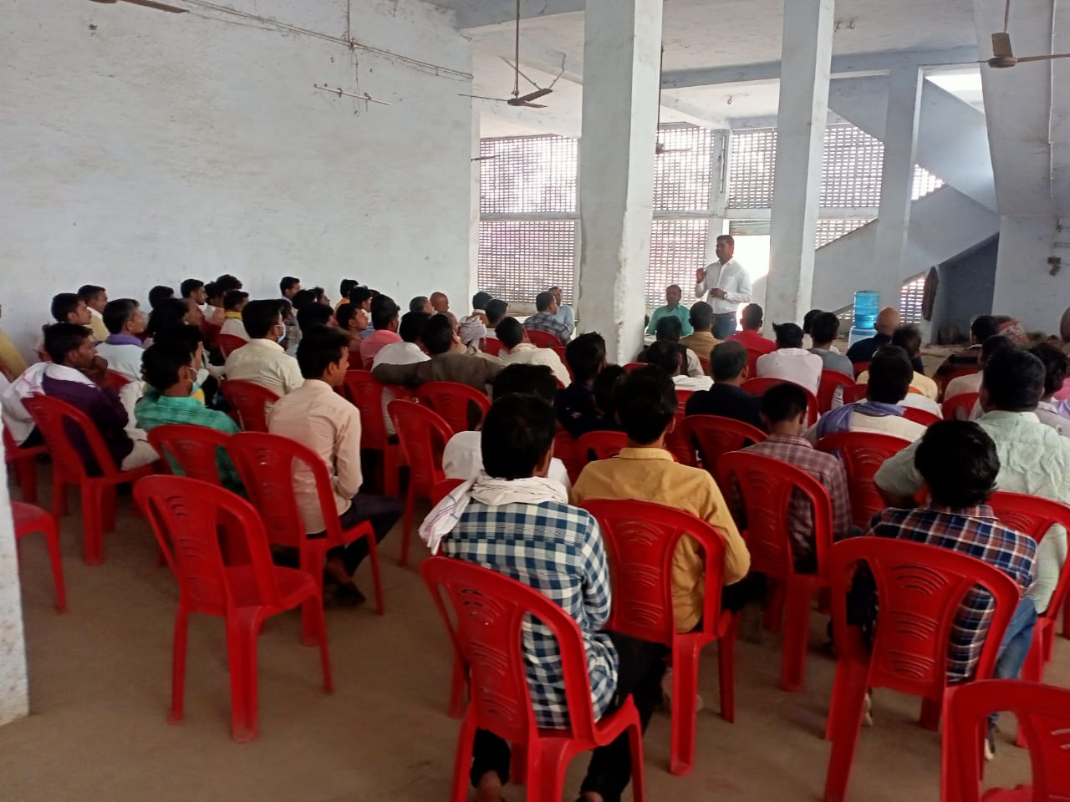
Health Camp Meeting

Slide 20
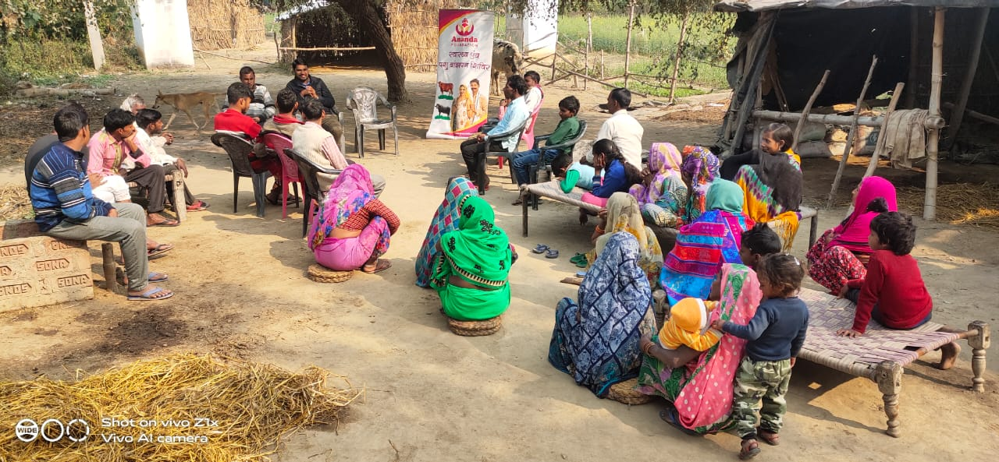
Women’s Participation in Health Camp

Slide 21
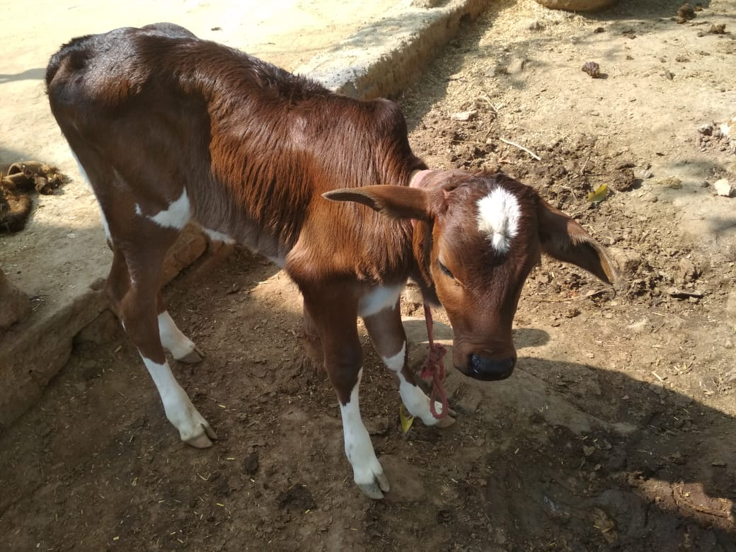
Breed Improvement

Slide 24
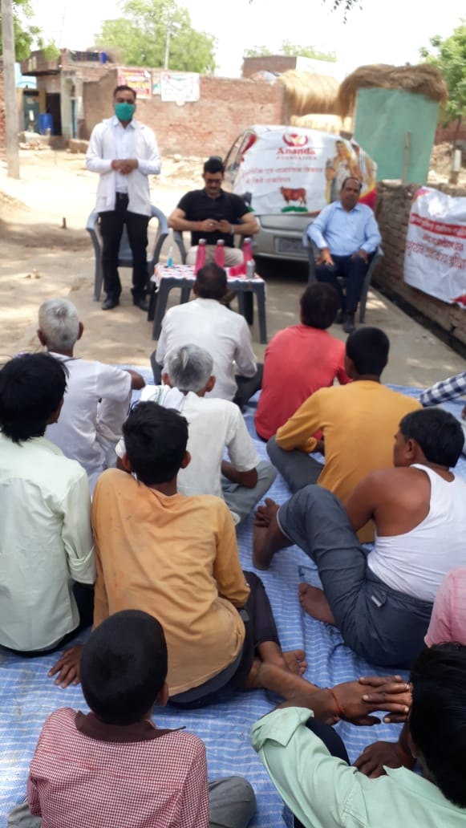
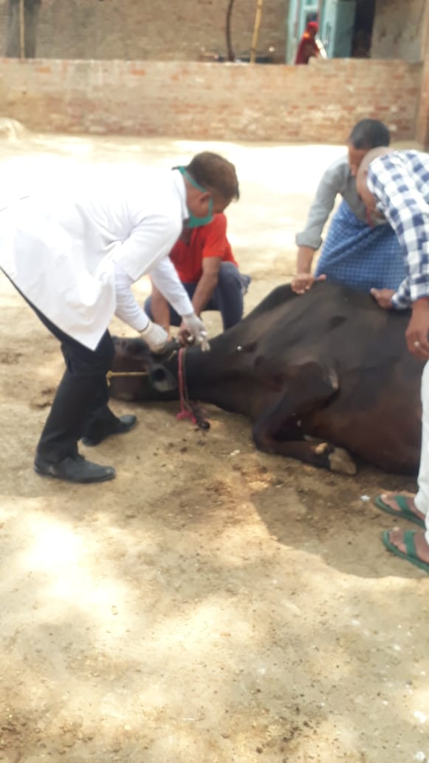
Vaccination Program Started on 2 MCC’s Fatehabad & Rasulabad

Slide 25
CATTLE HEALTH MANAGEMENT
Preventive
Curative

Slide 26
PREVENTIVE
PRESENT
SITUATION
NUTRICARE
CALCICARE
UTEROCARE

Slide 27
CURATIVE
Present
Situation
DEWORMER
I-VEX
Ayurvet
Albendazole

Slide 28
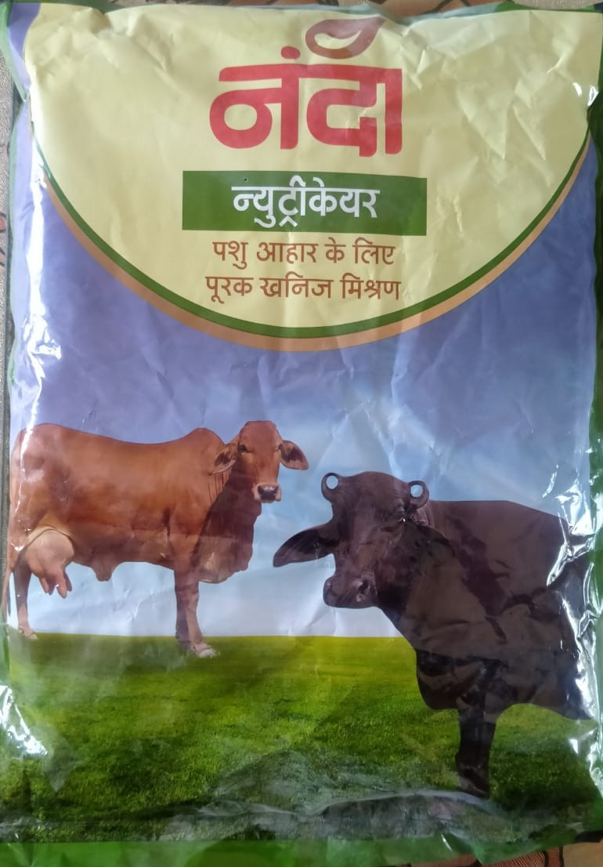
Product and health supplements
Nanda Nutricare

Slide 29
NUTRICARE BENEFIT
IMPROVE FERTILITY
Improves growth rates in Calves
Increase milk production
Improve reproductive efficiency and reduce intercalving period
Increase productive life of animals
Improve immunity of animals

Slide 30
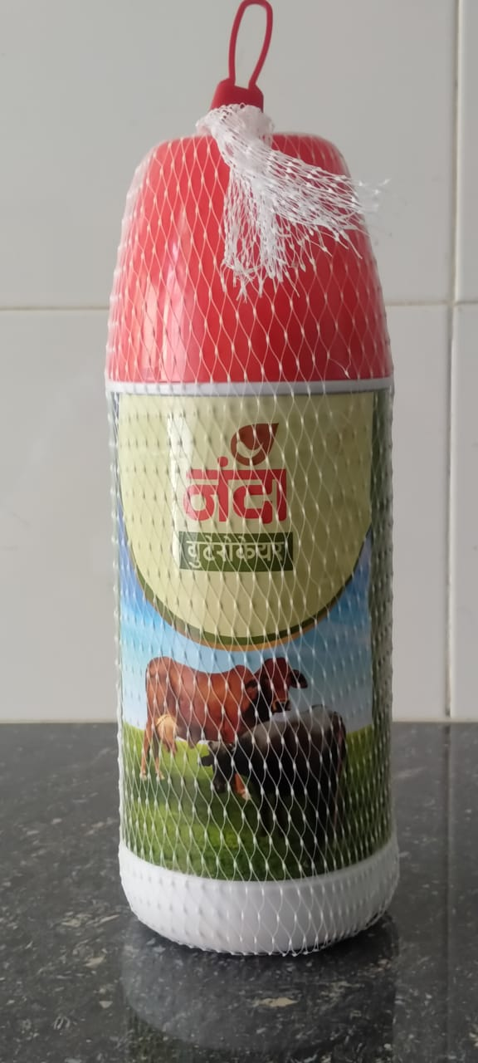
Product and health supplements
Nanda Uterocare

Slide 31
UTEROCARE BENEFIT
PREVENTS RETENTION OF FOETAL MEMBRANES.
PREVENTS DELAYED INVOLUTION OF UTERUS
ACTS AS UTERINE TONIC AND CLEASNSING AGENT
INDICATED IN REPEAT BREEDING AND HABITUAL ABORTIONS
CERVITIS,ENDOMETRITIS, VAGINITIS,FLUSHING OF LOCHIAL DISCHARGE, PYOMETRA ETC,

Slide 32
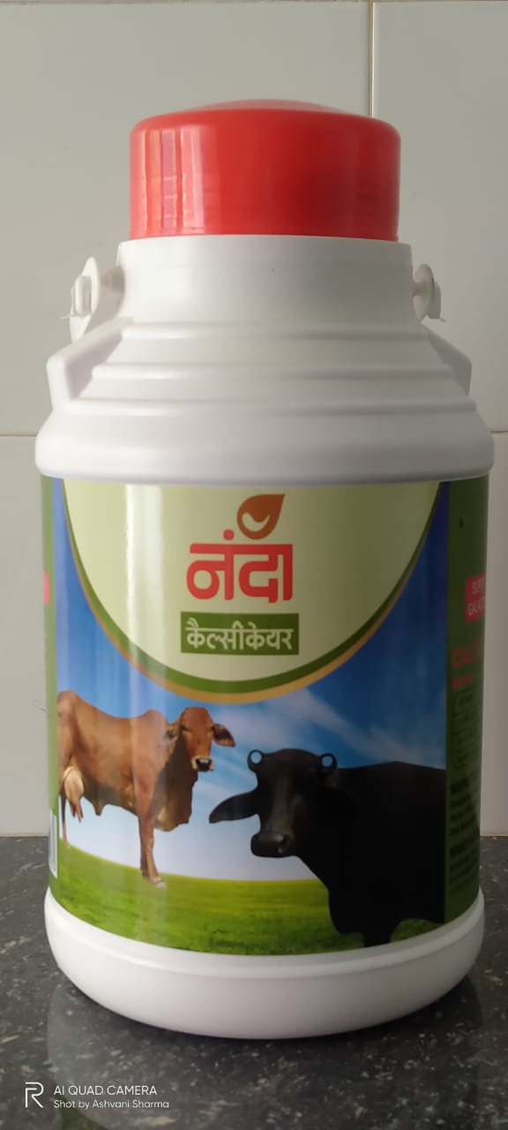
Product and health supplements
Nanda Calcicare

Slide 33
CALCICARE BENEFIT
BETTER BLOOD CALCIUM BALANCE AT CALVING.
INCREASE MILK YIELD
BETTER QUALITY OF COLOSTRUM
PREVENTS CALCIUM DEFICIENCYPROBLEMS
MILK FEVER, CALVING DIFFICULTIES, RETAINED PLACENTA WILL BE OVERCOME.
PREVENTS

Slide 34
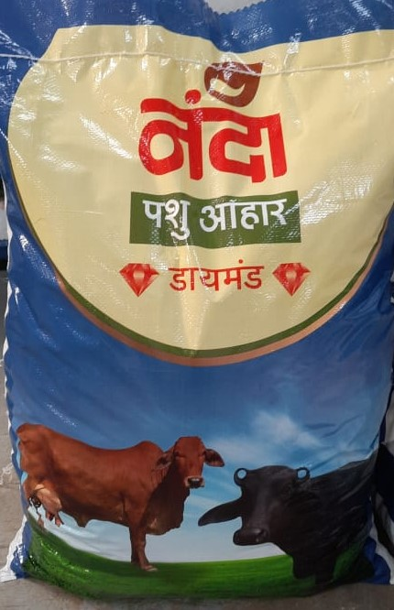
Product and health supplements
Nanda Cattle Feed

Slide 35
Farmers are accepting all the products introduced by the company.
Product are having high quality contents and composition due to this animals giving the optimum results.
We have a team of Veterinary Doctors and they were giving prescription and treatment for betterment of animal health , breed & feed

Slide 36
Sanitary Napkin
“A Personal Hygiene in Women Life”

Slide 37
Current Scenario in Rural India
Top Best Practices State |  | Moderate state |  | Bottom line State
State | % | State | % | State | %
Mizoram | 93 | Maharashtra | 50 | Bihar | 18
Tamilnadu | 91 | Karnataka | 56 | Uttar Pradesh | 19
Kerala | 90 | Andhra Pradesh | 43 | Chhattisgarh | 19
Goa | 89 | Hyderabad | 55

Slide 38
UP- At a Glance
Total Population 20.42Cr
Male Population 10.59Cr
Female Population 9.83Cr
Rural Population - 77.73Cr
Rural Female Population 6.83Cr

Slide 39
Sanitary Napkin – Potential Users
Age Group 15 to 55 is 62.8%
AGE GROUP:-
Potential Users
School/College going girls
Working Women
House Wife

Slide 40
Productivity Loss of Non User
Absenteeism for School going girls at average of 5-6 days per month.
Financial loss of Working Women in non formal Sector
Unhygienic Condition and Culture issue associated to mensuration

Slide 41
Modus Opearandii
Ananda Foundation will ensure complete ecosystem of for user for creating perpetual and self sustaining model.
Awareness – With the help of SHG awareness camp for the village women will be organized.
Affordable – Ananda Foundation will provide affordable price and in monthly pack and bigger pack.
Acceptable – The Product will be Sampled for first user to check the quality.
Accessible – It will be made available within Village.

Slide 42
Phase -1
Ananda Sakhi & Asha workers will be recruited from local area itself for covering 20 villages each.
Ananda Sakhi will be trained in product knowledge, social and culture issue taboo relating to mensuration.
Training in Marketing skills
Performance based Incentive for Ananda Sakhi.

Slide 43
Pending – 4 P of Marketing
Product
Price
Placement
Promotion

Slide 44
Thanks

